Slide 1
Disclaimer
This training resource was developed to be used with the CZ ID platform
In October, 2026, stewardship of CZ ID transitioned to UCSF and the platform was renamed to SeqtoID
These training materials are not being actively maintained and may not reflect differences between CZ ID and SeqtoID, subsequent changes to the platform, or current methods and best practices in metagenomic sequencing and analysis

Slide 2

Sample Report Metrics
Rapid Response – Updated Sept 2026
Notes:
Slides updated 07/02/2024

Slide 3
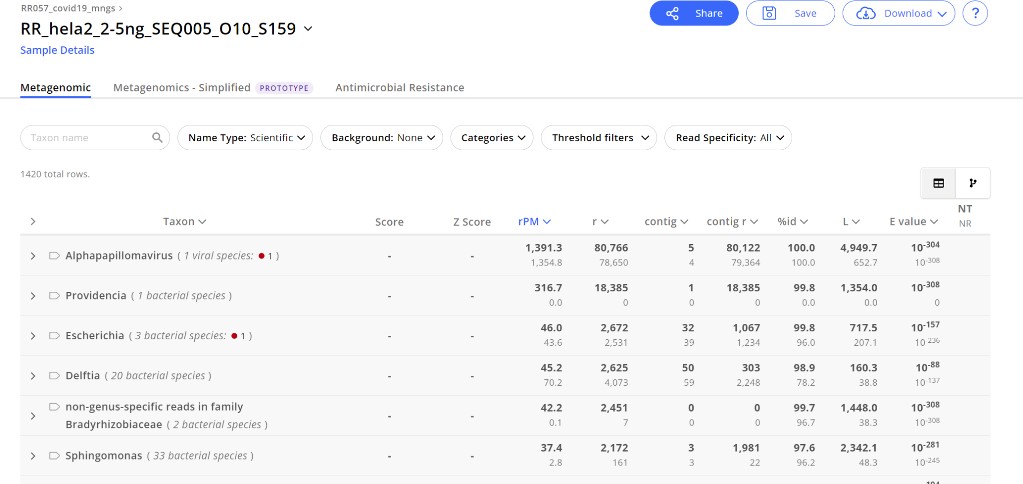
Reading the sample report

Slide 4
Gaining confidence in species calls using report metrics
Metric | Definition | Interpretation
rPM | Number of reads aligning to taxon per million reads sequenced (normalized metric) | Higher rPM = more confidence in the hit
r | Number of reads aligning to taxon | Higher r = more confidence in the hit
Contig | Number of assembled contigs | Longer contig = more confidence
Contig r | Number of reads aligning to assembled contigs | Higher Contig r = more confidence
% id | Average % identity of alignment to accession | Should be taken into account with other metrics
L | Average length of alignment of contigs and reads | Longer alignment = more confidence (if it’s divergent, L may not be high)
E value | Average expect value of alignment | Lower = more confidence
Notes:
High abundance doesn’t mean pathogen, but is a good place to start

Slide 5
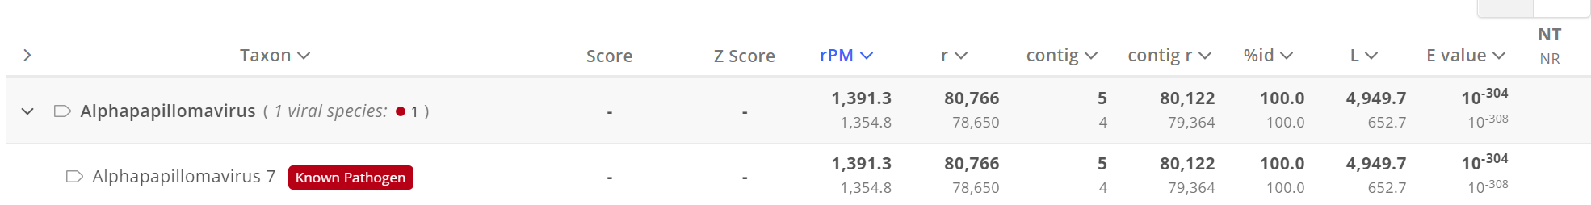
Each metric shows 2 results
NT = nucleotide database
NR = protein database

Slide 6
Each metric shows 2 results
NT = nucleotide database
NR = protein database
General Interpretation Notes:
Reads aligning to both databases: Good sign that the hit is true (more to it than that)
If a read is viral and only has a hit to the NR database: Hit could represent a divergent virus
If a hit is bacterial and it only has a hit to the NT database: Sequences may be aligning to the 16S rRNA region, which is not in the NR databases (should not be trusted)

Slide 7
Filters are helpful at removing false hits, but not perfect
Using the following filters is a good place to start:
NT L >= 50
  I only want to see taxa with at least 50 bp that align to the nucleotide database in NCBI
NT rPM >= 10
  I only want to see taxa with at least 10 reads per million that align to the nucleotide database. Reads per million is a normalized value that takes into account total reads.
NR rPM >= 1
  I only want to see taxa with at least 1 read that aligns to the protein database in NCBI. Having at least 1 hit to the protein database ensures that you are not hitting a conserved region.
Read more about filtering here.
Notes:
CZ ID only requires a 36 bp alignment to include taxa in the report

Slide 8
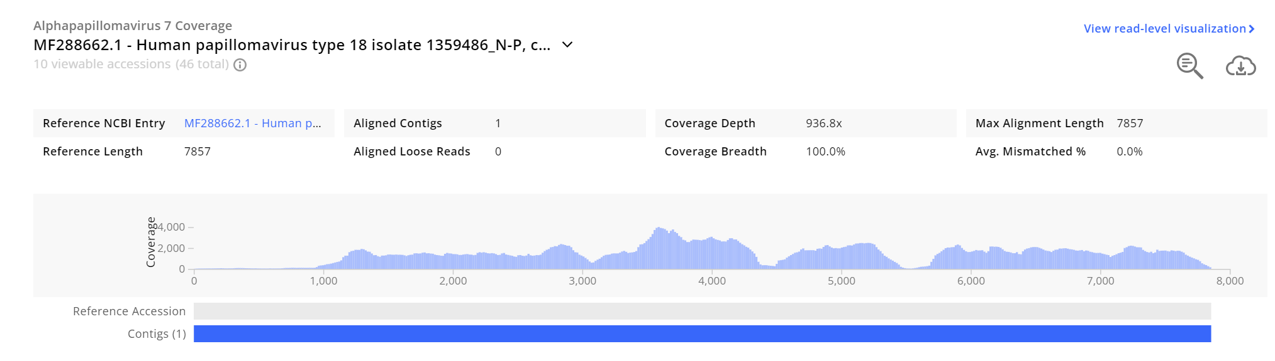
The coverage visualization is valuable for evaluating hits

Slide 9
Take into consideration the depth and breadth of the coverage (the higher, the better)
depth
breadth

Slide 10
Taking into account coverage breadth and depth
Depth | Breadth | How to Interpret
High | High | Provides you with confidence that this is a true hit!
Low | High | If there is coverage across multiple regions of the genome, this is likely a real hit. Evaluate the assembled contigs (NT L) and ensure the alignment is good (% identity).
High | Low | Depends on whether the small portion that has high coverage is unique to that particular taxon and on the quality of the alignment and assembly.
Low | Low | May be a result of genomic similarity at the 16S rRNA region (for bacteria)

Slide 11
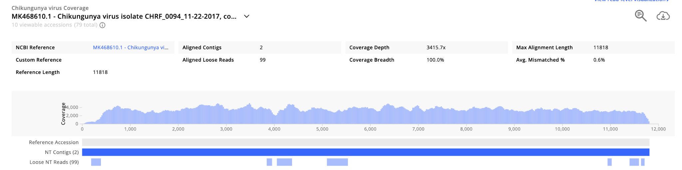
What do we think about this viral hit?

Slide 12
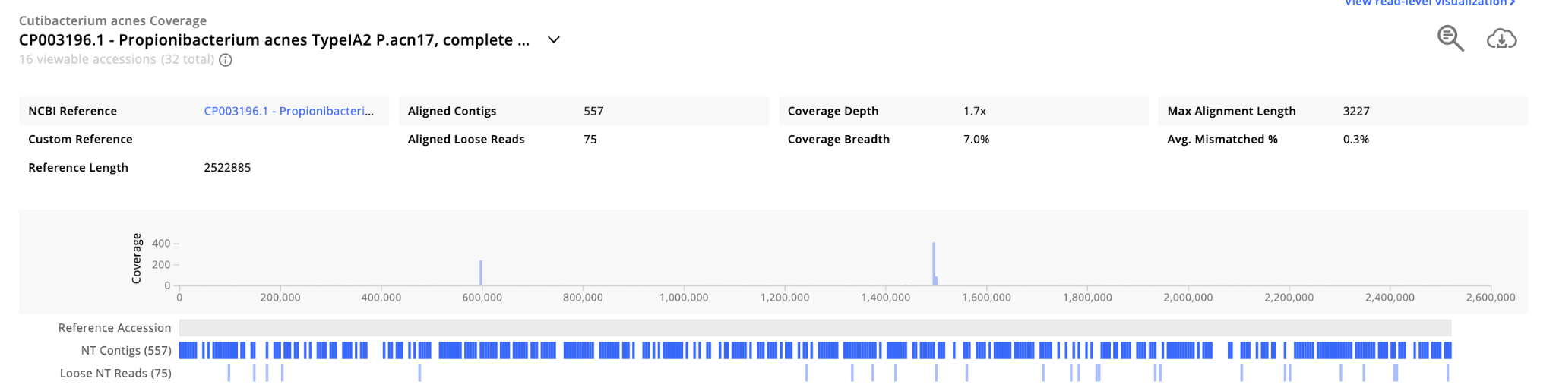
What do we think about this bacterial hit?
Notes:
Consider NT contigs and scale.

Slide 13
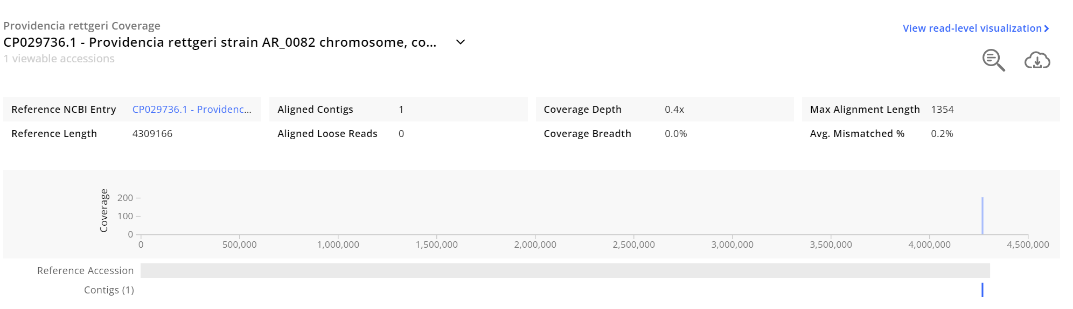
What do we think about this bacterial hit?
Notes:
Applies to all taxonomic groups.
Is this taxon interesting to our study?
Look at total reads for this sample -> low total, not surprising to have low coverage
BLAST -> specificity

Slide 14
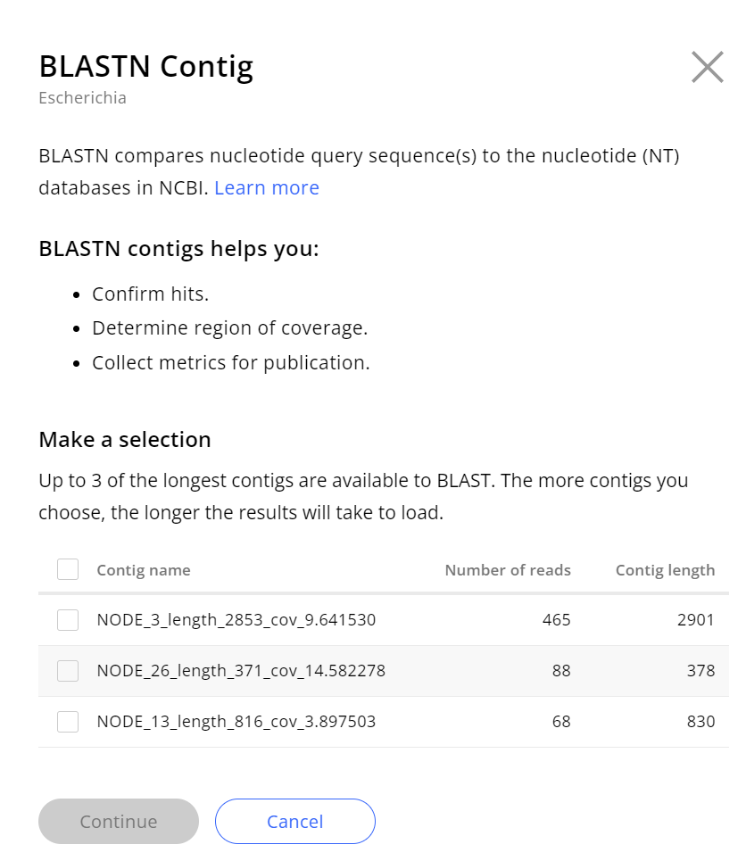
BLAST can be used for hit confirmation

Slide 15
Let’s do our own analysis!

